Slide 1
Acoustic Health Monitoring and failure localization of Suspension Bridge Main Cables
Morano, Cressman, Baima, Pickering, Smith

Slide 2
The Problem
Using the Claiborne Pell Bridge as a testing platform, it is possible to improve upon the existing methods for acoustic monitoring of suspension cables. It is possible to extend upon previous methods in order to pinpoint and determine the precise location and cable member which is damaged. This method will allow for the repair and monitoring of cable members without intrusive and damaging guess and check inspections.

Slide 3
Problem Statement (cont.)
A current visual inspection method of a 10ft length of cable, wedging down 5 inches at 8 points around the circumference, only exposes one side of 4000 linear feet of weave, or 0.007% of the total length. (study on the Bear Mountain Bridge)
Current exposure process can cost in the order of $2 million to expose, inspect, and reinstate ~320 ft of cable.

Slide 4
The Objective
The objective of this project is to design a sensor package in order to determine and examine individual cable breaks within the bundle of a suspension bridges main cable.
Execution using acoustic and ultrasonic sensors (passive and active) to localize cable degradation.

Slide 5
The Method
Two methodologies
Passive
Active
Determine which method will be more appropriate

Slide 6
Passive Acoustic Monitoring
Acoustic monitoring packages placed along main cable and at top anchor point.
Sensor package placed base anchor before cables split
Sensor packages placed at the anchoring point of each individual wire cluster

Slide 7
Passive Acoustic Monitoring
Break location ALONG cable determined through time delay and amplitude differences between top sensor and base cable sensor
Break location in wire cluster determined through time delay and amplitude differences between individual cable monitoring packages

Slide 8
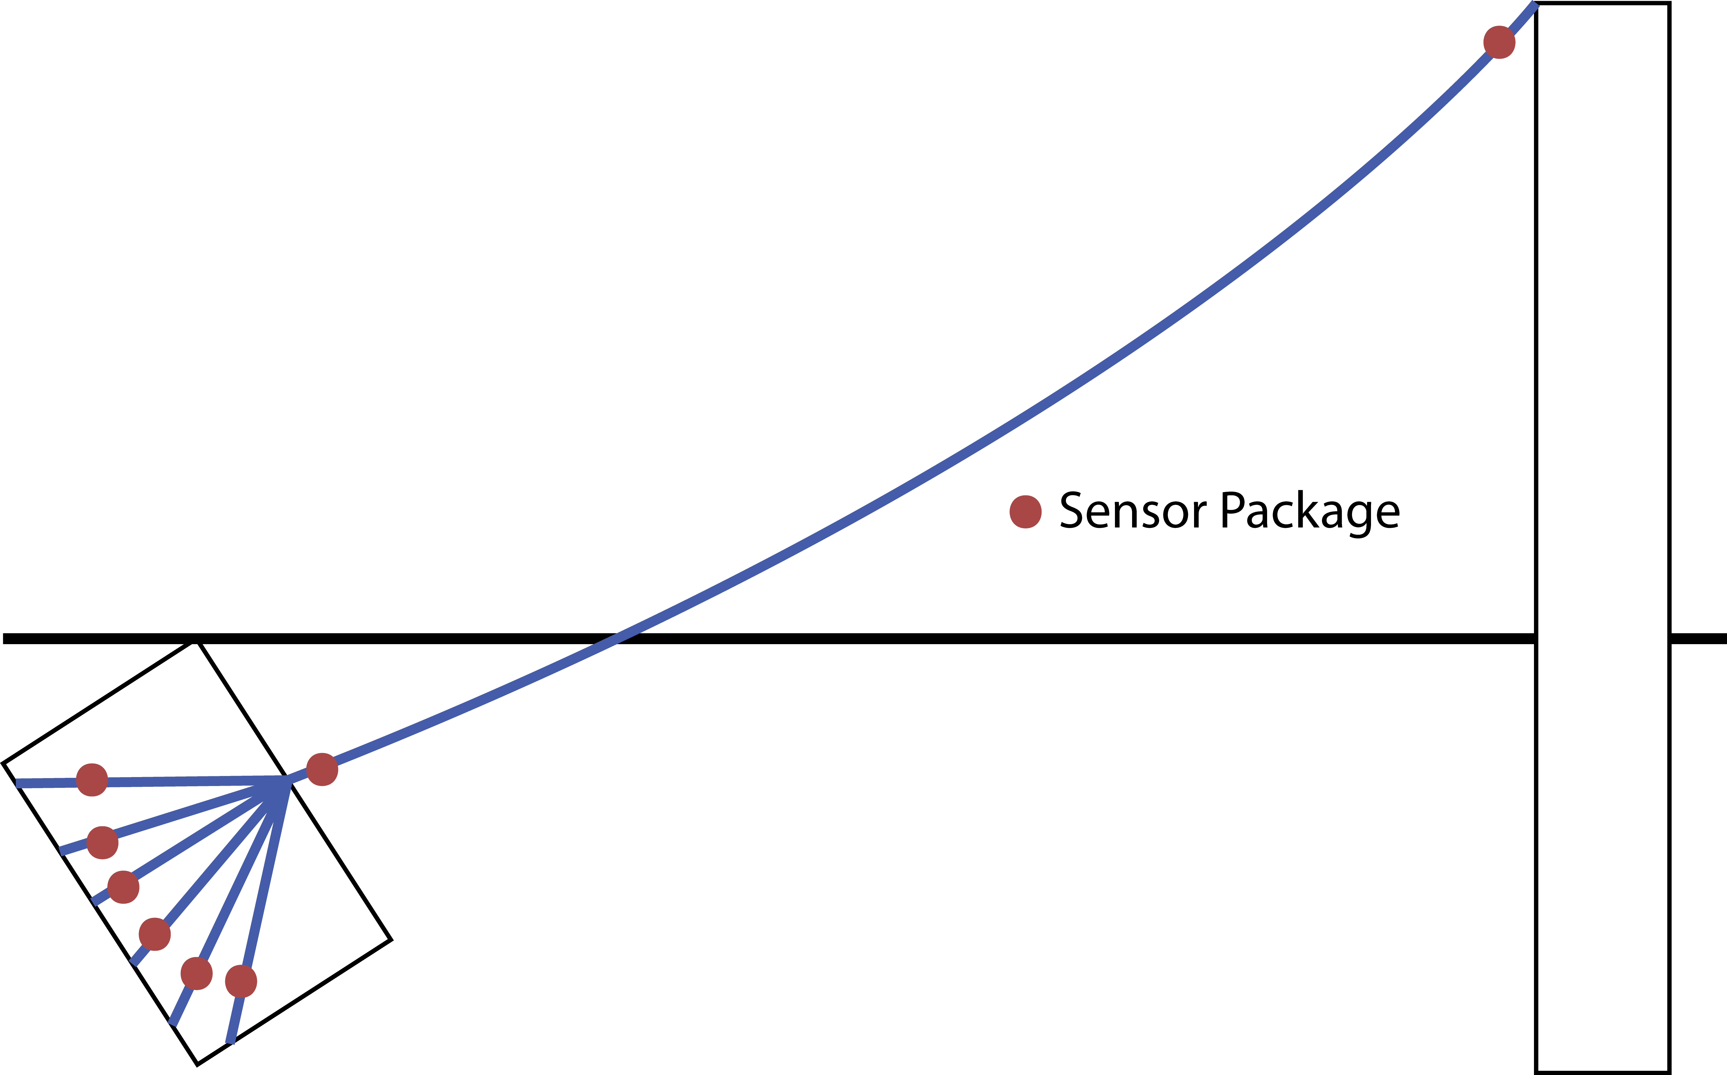
Passive Acoustic Monitoring

Slide 9
Passive Experiment
Experimental cable broken out to multiple anchor points and placed under tension
Sensor packages designed and attached along cable and at each anchor point
Cable broken or corroded to break and results analyzed.

Slide 10
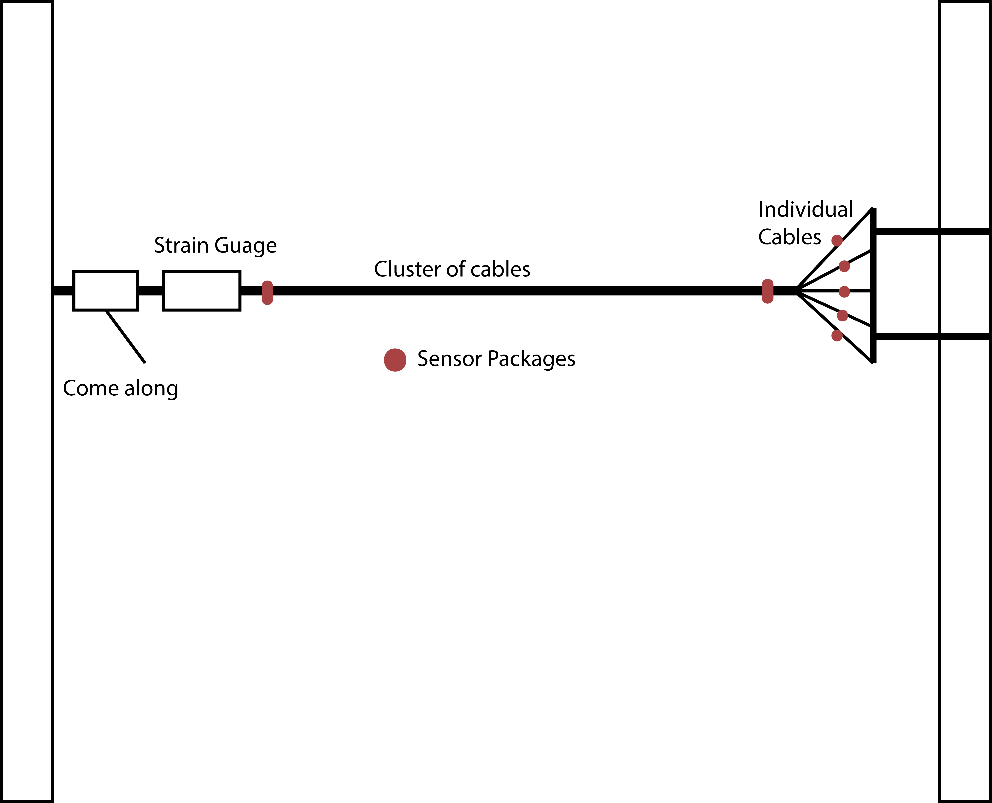
Passive Experimental Scope

Slide 11
Active Acoustic Monitoring
Ultrasonic signals injected in to each individual anchored wire.
Sensor packages at base of cables monitor reflected signal
Changes in signal reflection corresponds to corrosion or break in cable.
Experimentation to correlate between damage and acoustic response.

Slide 12
Active Acoustic Monitoring
More costly than passive sensing
May be able to predict failures before breakage occurs
Changes in acoustic properties correspond to changes in physical properties
Corrosion / Breaking / Wearing

Slide 13
Scope
Project will consist of a very wide scope
Research scope in order to determine methodology.
Experimental scope in order to develop a system.
Application to large scale structure and implementation.

